Slide 1
Welcome to Pre-Dental Club 2021-2022!
Welcome returning and new members!

Slide 2
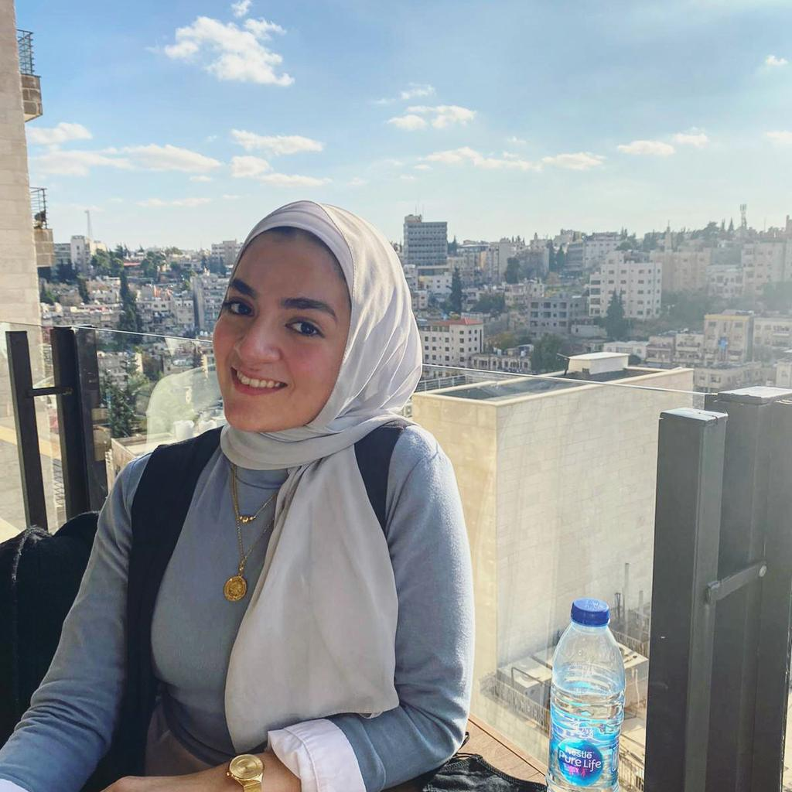
Maryam Othman - President
Major/Minor: Biology; Minor Public Policy
Fun Fact: I’m originally Palestinian and tie my identity very closely to my roots. My grandfather is my role model in everything I do <3
Goals: My goal for PDC is to create an understanding of being a dentist from several angles like policy, humanities, and academia.

Slide 3
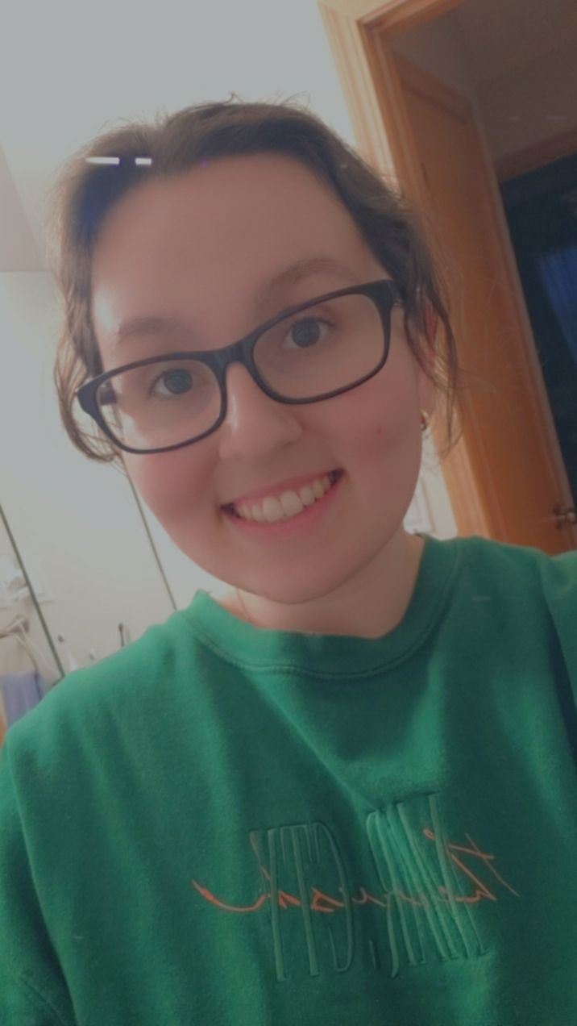
Camilla Mastela - Vice President
Major: Biology / Minor: Sociology
Fun Fact: I play video games to relax and have fun with my friends!
Goals: My goal is to help make PDC a welcoming place for all Pre-Dental students, providing a resourceful and exciting experience for all of our members. We all have the same goal in mind!

Slide 4
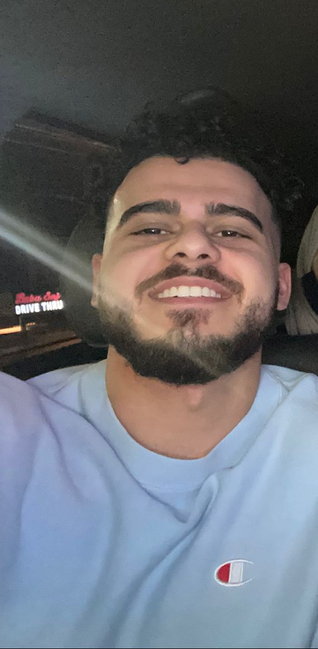
Mohammad Hassan - Secretary
Major: Biological Sciences
Fun Fact: I have an unhealthy addiction of buying new shoes
What you will do for PDC: I hope to show others that the daunting challenge of getting into dental school can be achieved by anyone through hard work!

Slide 5
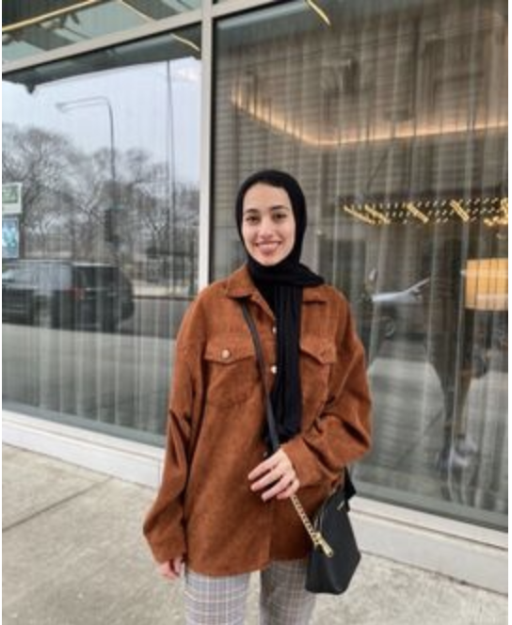
Aya Alshboul - Treasurer
​Name: Aya Alshboul
Major: Biological Sciences | Minor: History
Fun fact: I have probably visited every cafe near UIC so feel free to reach out if you’d like any recommendations :)
What you will do for PDC: I hope to strengthen UICs pre-dental community by helping to guide pre-dental students navigating the journey. Additionally, I hope to foster a stronger community and network between our members while also showing everyone how awesome the field of dentistry truly is!

Slide 6
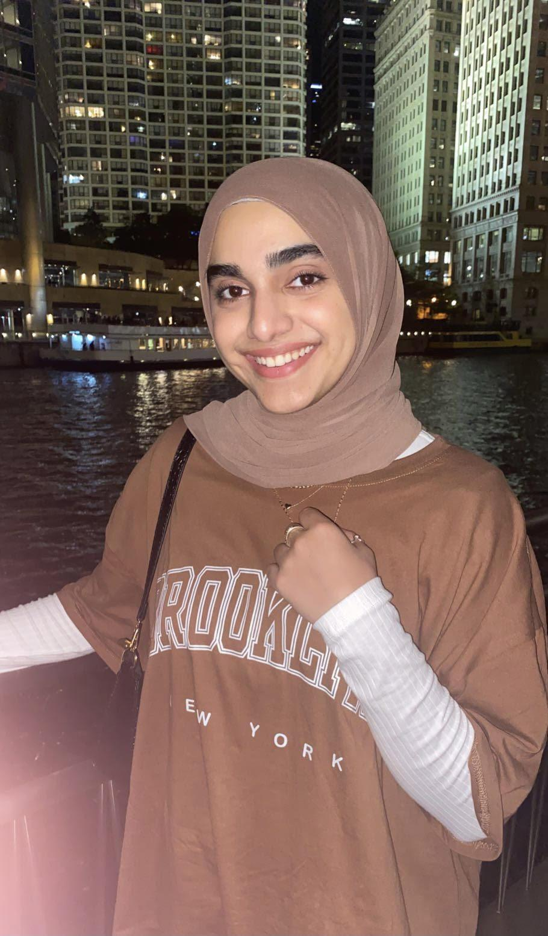
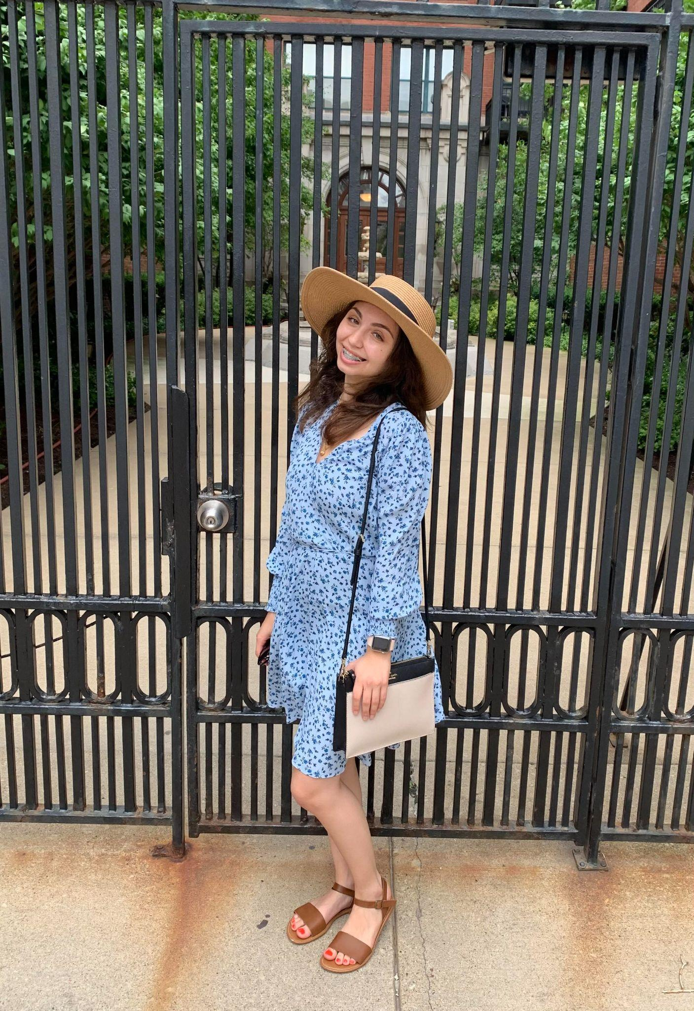
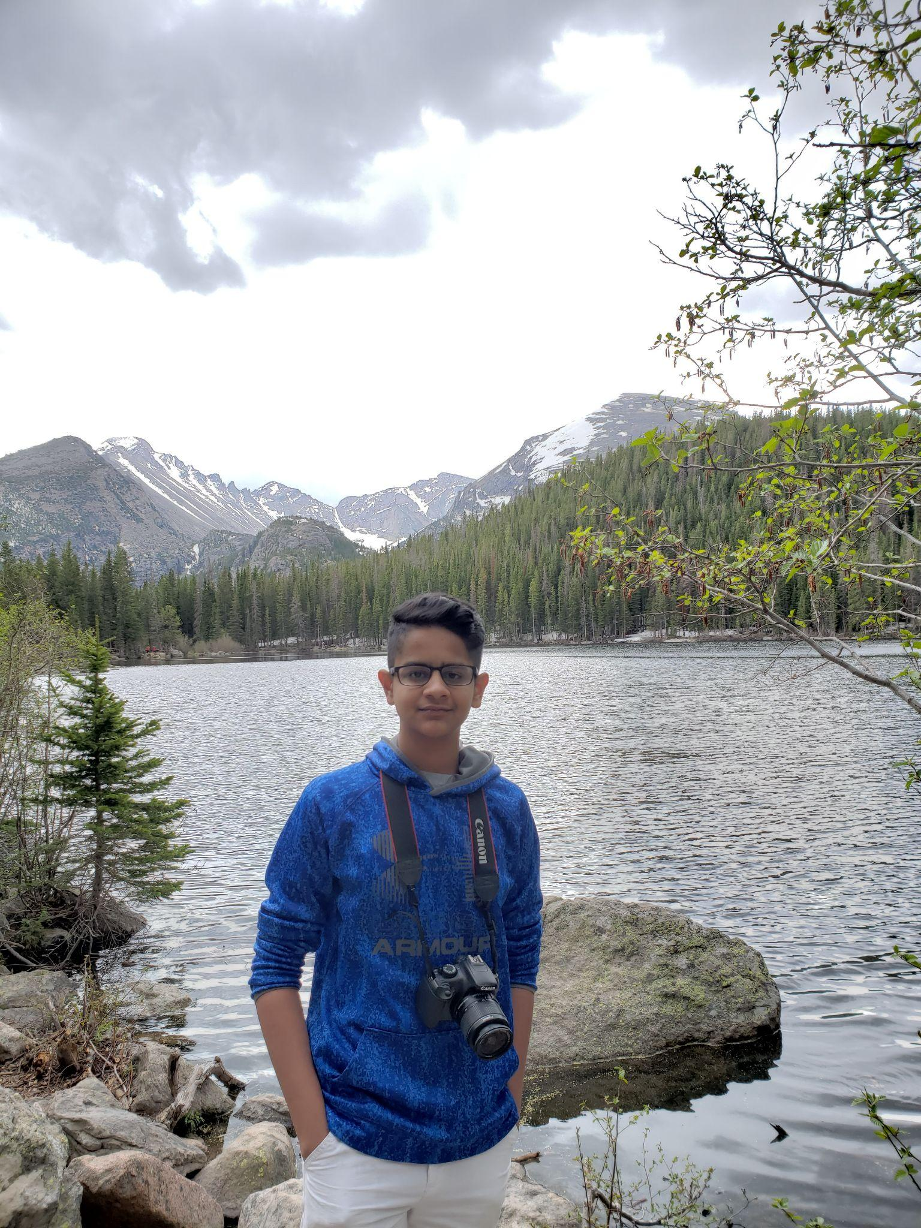
Club Representatives
Yarah Quad
Dania Hasan
Kartik Dixit

Slide 7
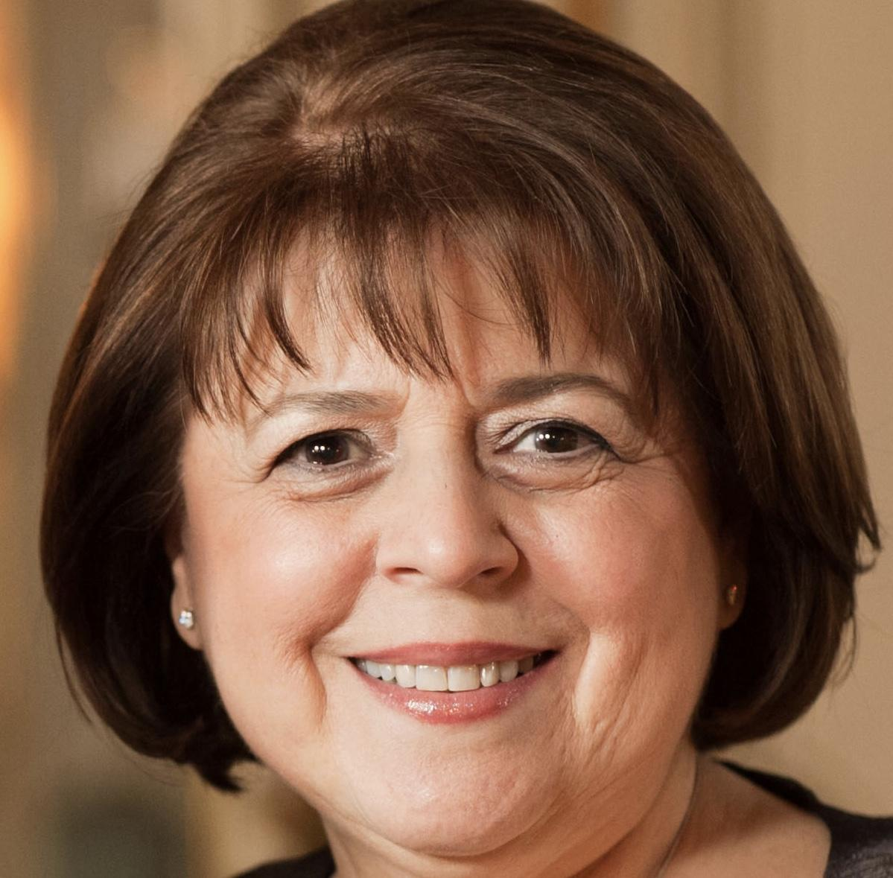
Our Club advisor
Dr. Rhonna Cohen
Email: rcohen@uic.edu

Slide 8
Our Purpose?
To supply our members with current information about health sciences.
To provide a medium for guest speakers to come and speak to those interested in oral health care.
To give back to the community by providing service oriented volunteer work.
To provide academic support for our members in regards to course advice, the DAT, and dental school application process.

Slide 9
Meeting Minutes/Post Meeting Surveys
Busy Schedule? WE UNDERSTAND.
Utilize our website: uicpdc.weebly.com
Minutes will be posted the night of the meeting or latest day after meeting
We want your FEEDBACK, we want your IDEAS, we want to answer any QUESTIONS you have!
Survey links (during and after semester) will be sent via email

Slide 10
Meeting Formats; Moving Forward
We understand that with the state moving into Phase 5 of the Restore Illinois Plan, many businesses, schools, and other places are fully reopening to the public. However, we listened to your feedback and understand your concerns and opinions.
As an Executive Board, we’ve made the decision to keep our informational meetings and guest speakers online via ZOOM, to ease our way back into in-person and on-campus. What will be mostly on-campus, are our socials and volunteering events (potential socials can still be online depending on the activity.) We want to start seeing our PDC family again, but we also want to ensure all of our members are comfortable with the activities we have in store.
This format is subject to change as we continue on in the school year.

Slide 11
How do I become an Active Member?
15x PTS required to remain on the MASTER LIST and to be considered ACTIVE for the 2021-2022 UIC Academic Year.
(TENTATIVE TO CHANGE IF NECESSARY)
Dues: no dues
Active Member Roster will be available on our website for every academic year.
Your participation makes you a well-rounded student

Slide 12
Point System
Ways to Earn Points
2x PTS earned per meeting attended
2x PTS earned per outside event/volunteer event attended with PDC (e.g. COD Open House, COD Pre-Dental Night, Midwinter Meeting, etc.) (NO LIMIT)
2x PTS earned per 10hrs Shadowing. (Signature of DR required for verification) (MAX 6x PTS per semester)
5x PTS earned for registering to be a ASDA pre-dental member.
1x PTS for specific surveys throughout the year
1x PTS for providing the club with volunteer opportunities through our form (MAX 4 PTS)
Participating in our oral health teaching video (TBD)
Penalties
4x PTS deducted for last minute cancellations of ANY committed event unless provided with *valid excuse through email by no later than 10pm day of the event.
1x PTS deducted for failure to follow instructions for event. (e.g. improper dress attire, late arrival, etc.)
*we will not be accepting toothbrushes and toothpaste for pts this semester due to sanitary issues.

Slide 13
Point Status
15 points = Active Member Status
20 points = Honorary Member Status
30 points = Elite Member Status

Slide 14
T-SHIRTS
We’re accepting T-shirt designs! If you had an idea for a shirt, or didn’t like last year’s, now’s your chance to create a design for this year’s!
If you have T-shirt design ideas, submit them to the UIC PDC email! We’ll be accepting designs until [insert date here].
Since we’ll be collecting dues this year as a result of restrictions loosening up, T-shirts will be based on member activity and paid dues. Exceptions will be considered on a case-by-case basis.
We look forward to seeing what you all come up with!

Slide 15
How do I join the Executive Board next year?
25 REQUIRED to apply to run for a position for 2021-2022 (decided closer to election date). Application deadline date is TBD.
All four positions require 5-minute speech.
Can only run for one position
Get to know the current e-board so you can have an understanding of what they do.

Slide 16
Volunteer Events
Marathons
Oral health workshops
Service Events
Packaging for the under served

Slide 17
OPDM (it’s back!)
Outstanding Pre-Dent of the Month
Recognizes Pre-Dental Members that go out of their way to make a difference in the community.
Nominations for future OPDM's must be emailed uicpdc32@gmail.com no later than 7 days before the end of the month. OPDM's will be voted on based on: Meeting Attendance, Participation, Attitude, Going Above and Beyond, etc.)

Slide 18
Mentor Program
1
An opportunity to meet your peers
2
Have a close Mentor relation with a Dental student
3
A leadership opportunity
You will be in a group chat with your peers and have the opportunity to learn from each other
Each group will have a dental student from UIC COD to answer any questions and give advice
Juniors and Seniors can apply to be a mentor to lead the groups and set up meetings
Earn 5 points

Slide 19
How to Apply to the Mentor Program
Mentees: fill out the form sent to you by email and you will be placed in a group
Mentors: Apply if you are a Junior/Senior and meet requirements
(5 points)
Reach out to Maryam Othman (mothma5@uic.edu) for questions or concerns about the buddy program

Slide 20
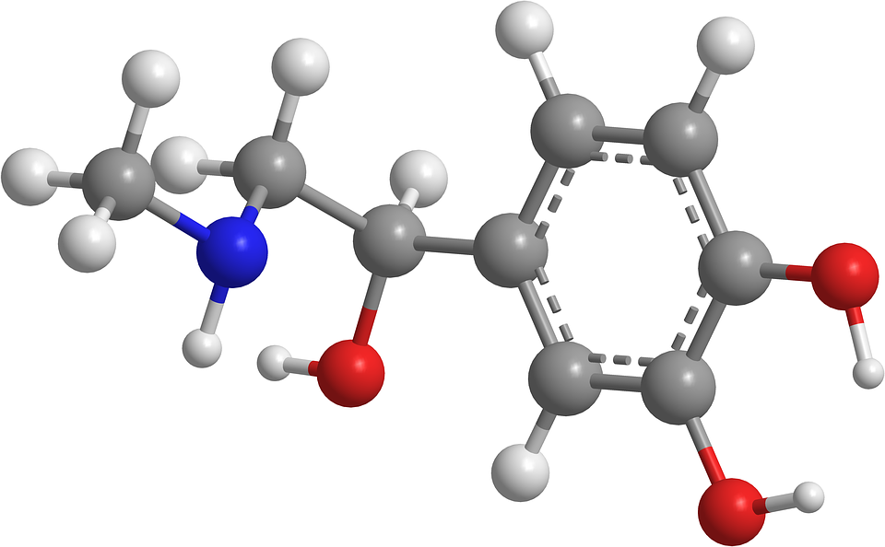
Ongoing DAT Group Chats
Understanding that the DAT is not an easy journey, we have launched a DAT study group. Within this group, you will have the opportunities to freely ask as many specific DAT-related questions to other members who are also actively studying. Additionally, we will to offer various opportunities that may be helpful to you
*We ask that this remain exclusively for those ACTIVELY studying for their DAT in order to be as efficient as possible :)
“The MCAT is hard and the MCAT is important”
I am so sorry if you understand this

Slide 21
DAT Book Circle
We’ll be continuing our DAT Book Circle this year!
What is the Book Circle?
Created last year, it to allows students to share their DAT books/materials with other students who could have better use to them when studying for the DAT.
Any DAT Books/Materials you have, let us know! Email Camilla Mastela (cmaste6@uic.edu) and let us know if you or someone you know would like to give away any materials useful for other PDC students studying for the DAT.

Slide 22
Website & Social Media
Website: uicpdc.weebly.com/__

Slide 23
Office Hours
When: Bi-monthly
Time: TBA through email
Where: Our good old friend ZOOM
Additional hours/meeting times can be scheduled by appointment with any e-board member via email (uicpdc32@gmail.com)

Slide 24
Word of advice :)

Slide 25
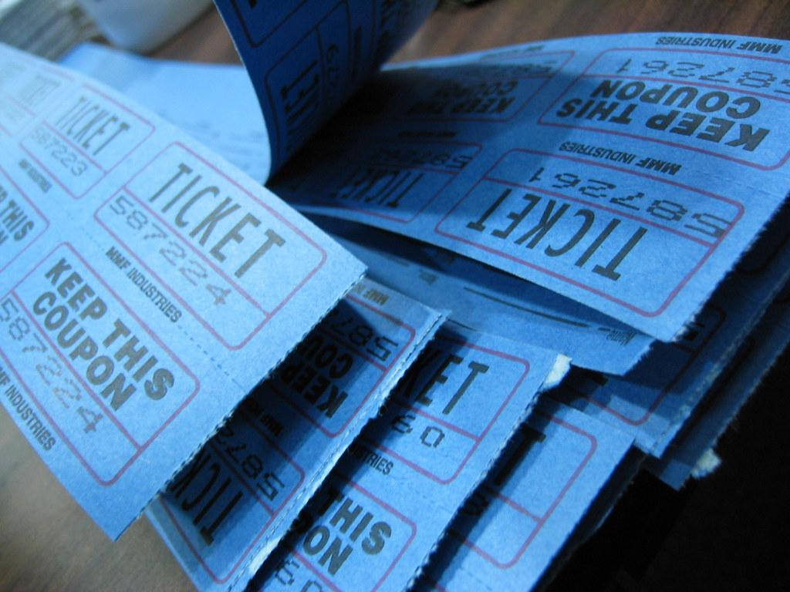
Raffle!

Slide 26
Thank you for listening along!
Any Questions?
7087178934

