Slide 1
April 24th, 2019
Pre-Dental Club GBM

Slide 2
Announcements
Congratulations to the 2019-2020 Executive Board!
President: Laura Habeeb
Vice President: Lazma Deeb
Treasure: Edgar Escobar
Secretary: Joseph Guliana
Active Member certificates have been emailed out!
LAST Office Hours of the Year:
THIS Friday, April 26th from 1:30-3:00pm in SES (last day to pick up t-shirts)
Post-semester survey (due 4/30)
Returning Members: please sign-up for 2019-2020 PDC email list!
PHSC Sign-Up see Jessica Samawi

Slide 3
What is the DAT?
The DAT is composed of multiple-choice test items presented in the English language. The test is developed according to established test specifications. The DAT consists of a battery of four tests: Survey of the Natural Sciences, Perceptual Ability, Reading Comprehension, and Quantitative Reasoning.
$450 test fee
Can be taken up to three times (with 90 days between retakes)
Scores are valid for two years

Slide 4
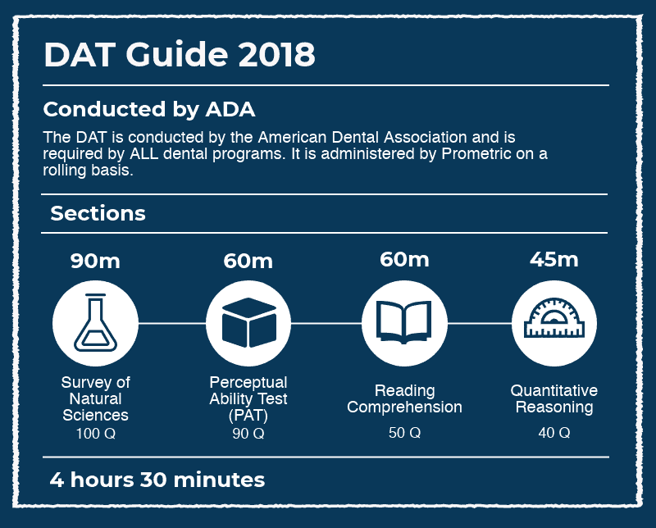
Section Breakdown
Survey of the Natural Sciences: Biology
-Cell and Molecular Biology
-Diversity of Life
-Structure and Function of Systems
-Developmental Biology
-Genetics
-Evolutions, Ecology, and Behavior
Survey of the Natural Sciences: General Chemistry
-Stoichiometry and General Concepts
-Gases
-Liquids and Solids
-Solutions
-Acids and Bases
-Chemical Equilibria
-Thermodynamics and Thermochemistry
-Chemical Kinetics
Survey of Natural Sciences

Slide 5
Section Breakdown
(General Chemistry continued)
-Oxidation-Reduction Reactions
-Atomic and Molecular Structure
-Periodic Properties
-Nuclear Reactions
-Laboratory
Survey of the Natural Sciences: Organic Chemistry
-Mechanisms
-Chemical and Physical Properties of Molecules
-Stereochemistry
-Nomenclature
-Individual Reactions of Major Functional Groups
-Acid-Base Chemistry
-Aromatics and Bonding
Survey of Natural Sciences (continued)

Slide 6
Section Breakdown
Perceptual Ability Test
-Angle Ranking
-Hole Punching
_Keyholes
-Top-Front-End
-Pattern Folding
-Cube Counting
Reading Comprehension
-three reading passages on various scientific topics
Quantitative Reasoning (Math)
-Algebra (equations and expressions, inequalities, exponential notation, absolute value, ratios and proportions, and graphical analysis); Data Analysis, Interpretation, and Sufficiency; Quantitative Comparison; and Probability and Statistics
PAT, Reading Comprehension, and QR

Slide 7
How is the DAT Scored?
Each section is scored 1-30. The score breakdown gives averages for Academic Average (everything but PAT), Total Science (Bio, Gen. Chem, Orgo), and Perceptual Ability:
AA/TS/PA

Slide 8
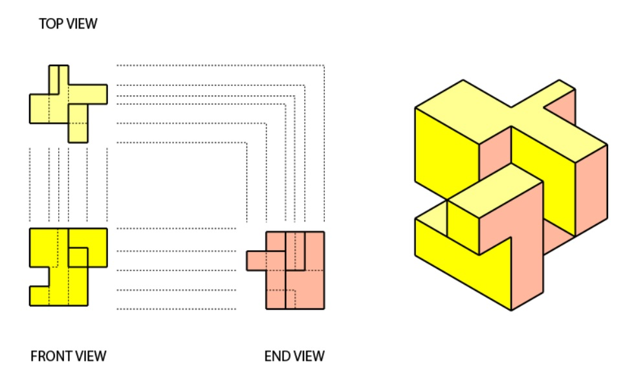
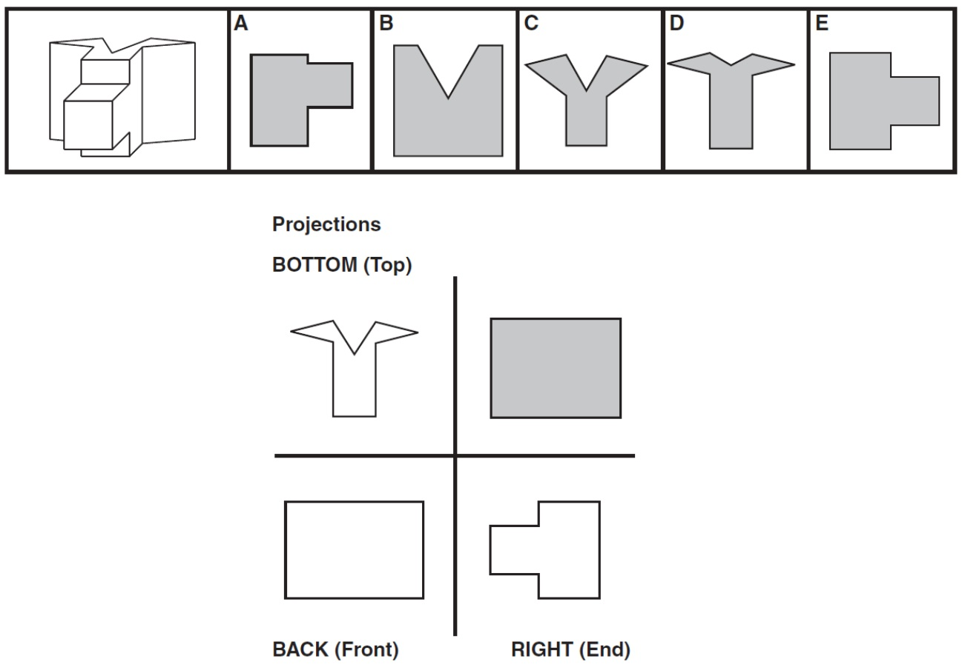
PAT Hints (what is this even asking??)
Keyholes
Top Front End

Slide 9
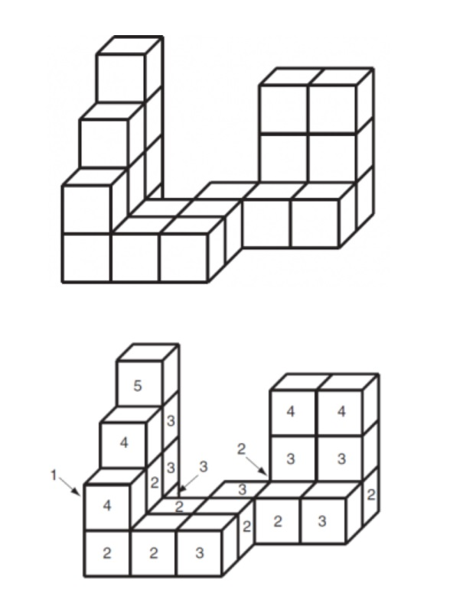
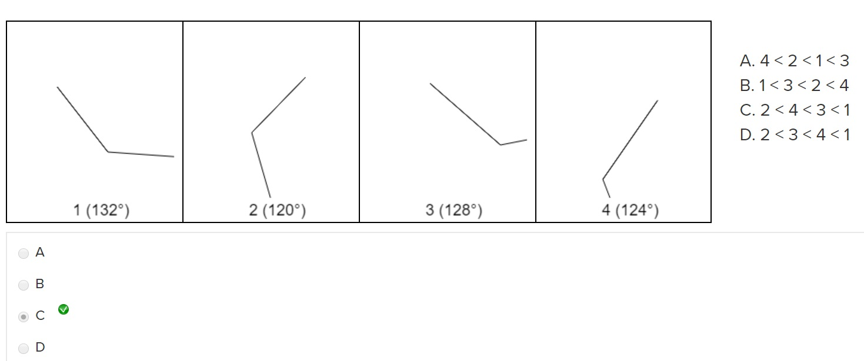
PAT Hints (what is this even asking??)
Angle Ranking
Cube Counting

Slide 10
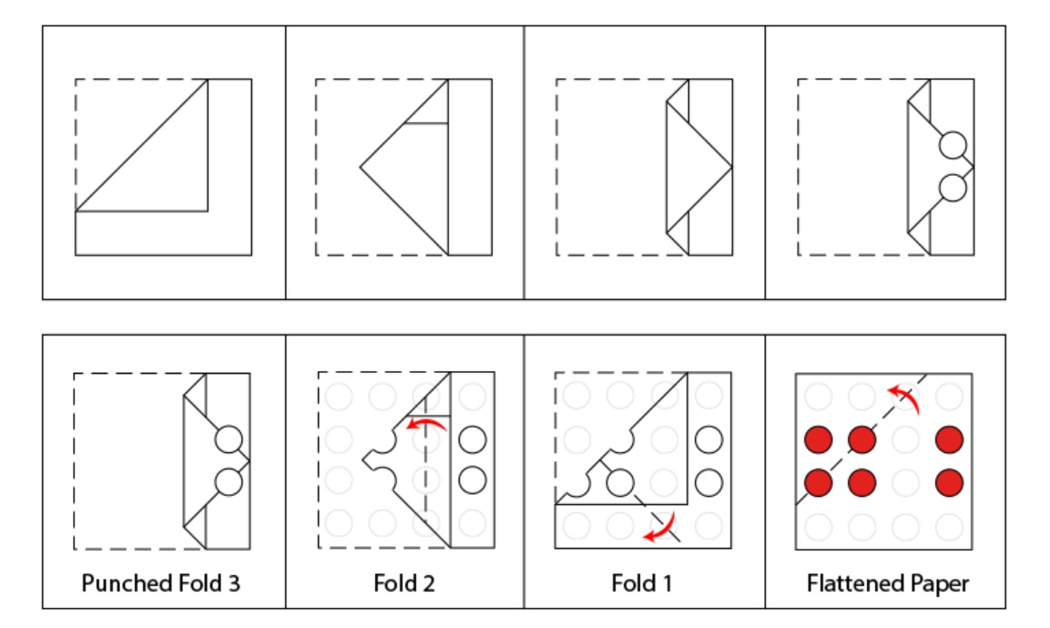
PAT Hints (what is this even asking??)
Hole Punching

Slide 11
Let’s practice some DAT questions!
Links to sources used:
http://www.ada.org/~/media/ADA/Education%20and%20Careers/Files/dat_examinee_guide.ashx
https://www.princetonreview.com/medical/dat-information
https://www.princetonreview.com/medical/dat-information
https://www.kaptest.com/study/dat/whats-good-dat-score/

Slide 12
KAHOOT GAME LINKS
Spring 2019 Game:
https://play.kahoot.it/#/?quizId=3155cd03-cf15-4fa2-9235-e3ca6868462b
Fall 2018 Game: https://play.kahoot.it/#/k/201ad9e3-9a7a-4456-8ac7-49e36f2b985b
Spring 2018 Game: https://play.kahoot.it/#/k/0b20304d-bbf2-4270-91b1-6d54d75ad5a9
Fall 2017 Game: https://play.kahoot.it/#/k/0b20304d-bbf2-4270-91b1-6d54d75ad5a9

Slide 13
Acknowledgements

Slide 14
Please take a moment to applaud yourselves!
For the 2018-2019 School Year:
276 people on our email list (+16 since Fall)
113 members who paid dues (+14 since Fall)
59 members who reached active status
Recognitions:
Active members of PDC
Volunteered this year with PDC
Graduating this Spring
Made a friend in PDC
Feel more prepared as a pre-dental

Slide 15
