Slide 1
Academic Pathway to Dental School
Presented by PDC

Slide 2
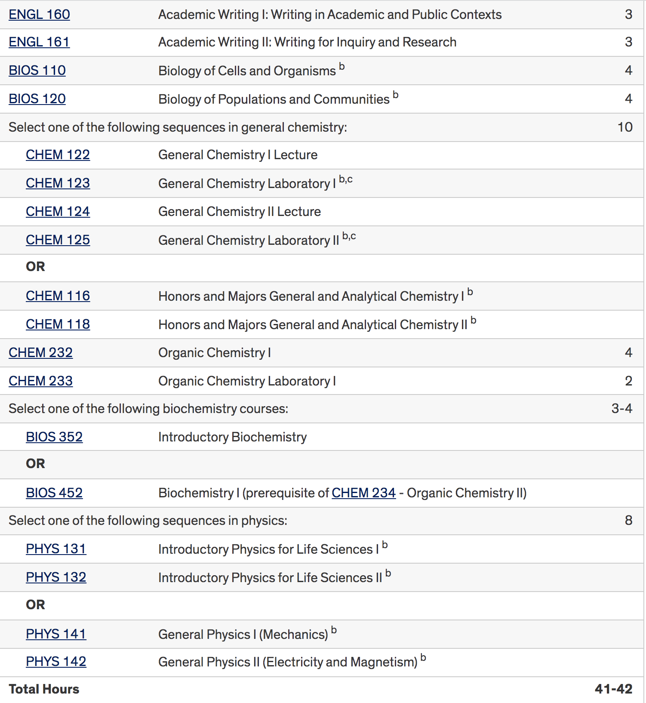
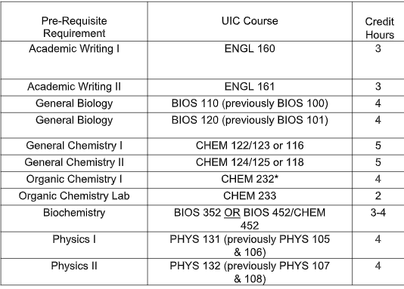
Ma
UIC COD Pre-Requisites

Slide 3
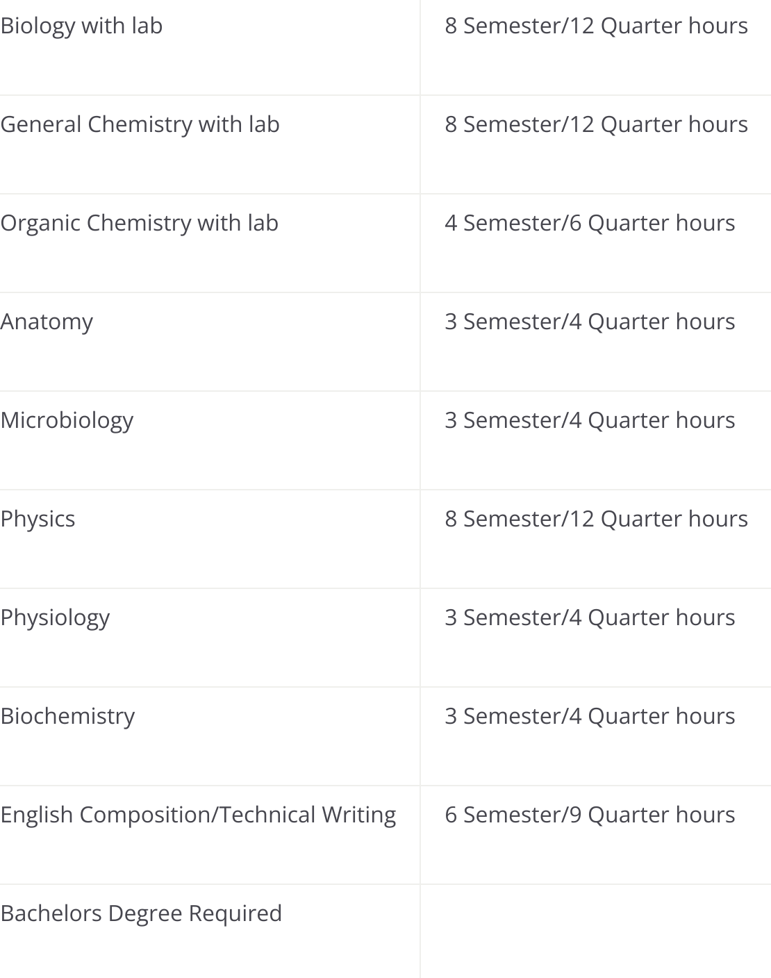
Ma
MWU-IL
Pre-Requisites

Slide 4
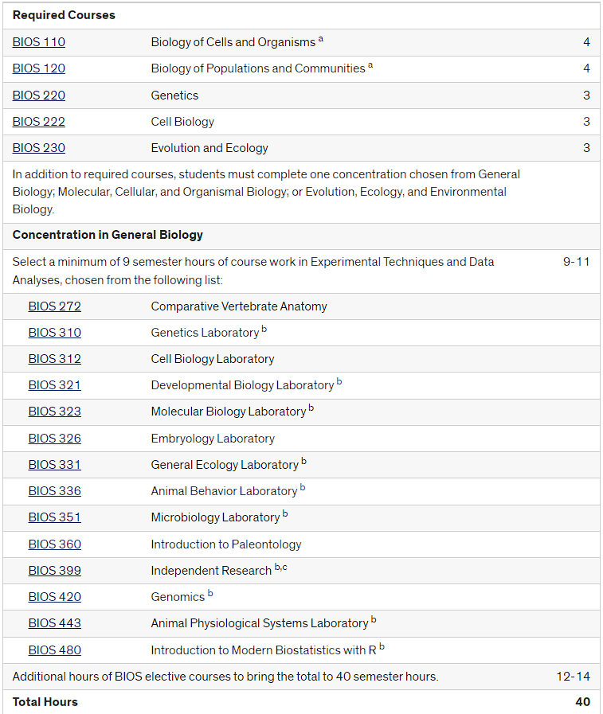
Do you have to major in BIOLOGY?
C
Majoring in Biology is NOT required by any means!
Other science majors give you the same opportunity to complete prerequisites
Many will advise you to AVOID just sticking to just Biology; take classes, declare a minor that you’re interested in which you’ll excel in!
“But what if I like Bio and Bio works best for me?” - Completely okay! There’s nothing wrong with Biology (which helps a lot with pre-requisites.)
Academic Proficiency, Consistency, and Well-Roundedness
Dental Schools love to see growth + consistency
Ability to challenge yourself and handle more and more rigorous course loads is what’s most important (this is why many follow a holistic approach!)

Slide 5
Common Pre-Dental Majors
C
Academic strength & Well-roundedness > Cookie-Cutter Student
Majoring in the sciences is not a requirement for dental school!
A good foundation in sciences is required; demonstration of strong academic performance is much more valued
Showcase the things that make you, YOU! + What you’re interested in!
62% of UIC COD D1’s in the past 5 years; Biological Sciences Majors
Top Majors following Bio;
Chemistry / Physical Science / Biochemistry (~11%)
Pre-Dentistry / Community Health / Health Science (~6%)
Social Science [Psy, Soc, History, PoliSci] (~6%)
10% of this year’s D1 Class have Non-Specified Other Majors vs. past D1 classes (~3%)
Note; these are just stats of previous dental students! This is not an indication of your chances to Dental School! Each applicant’s experiences & strengths are different from one another.
**note these are stats taken from https://dentistry.uic.edu/wp-content/uploads/sites/741/2021/09/DMD-classprofiles-2021-2025-short-version.pdf **

Slide 6
Major in Biology Requirements
Ma
BS with a Major in Biological Sciences—Evolution, Ecology, and Environmental Biology Concentration
BS with a Major in Biological Sciences—General Biology Concentration
BS with a Major in Biological Sciences—Molecular, Cellular, and Organismal Biology Concentration

Slide 7
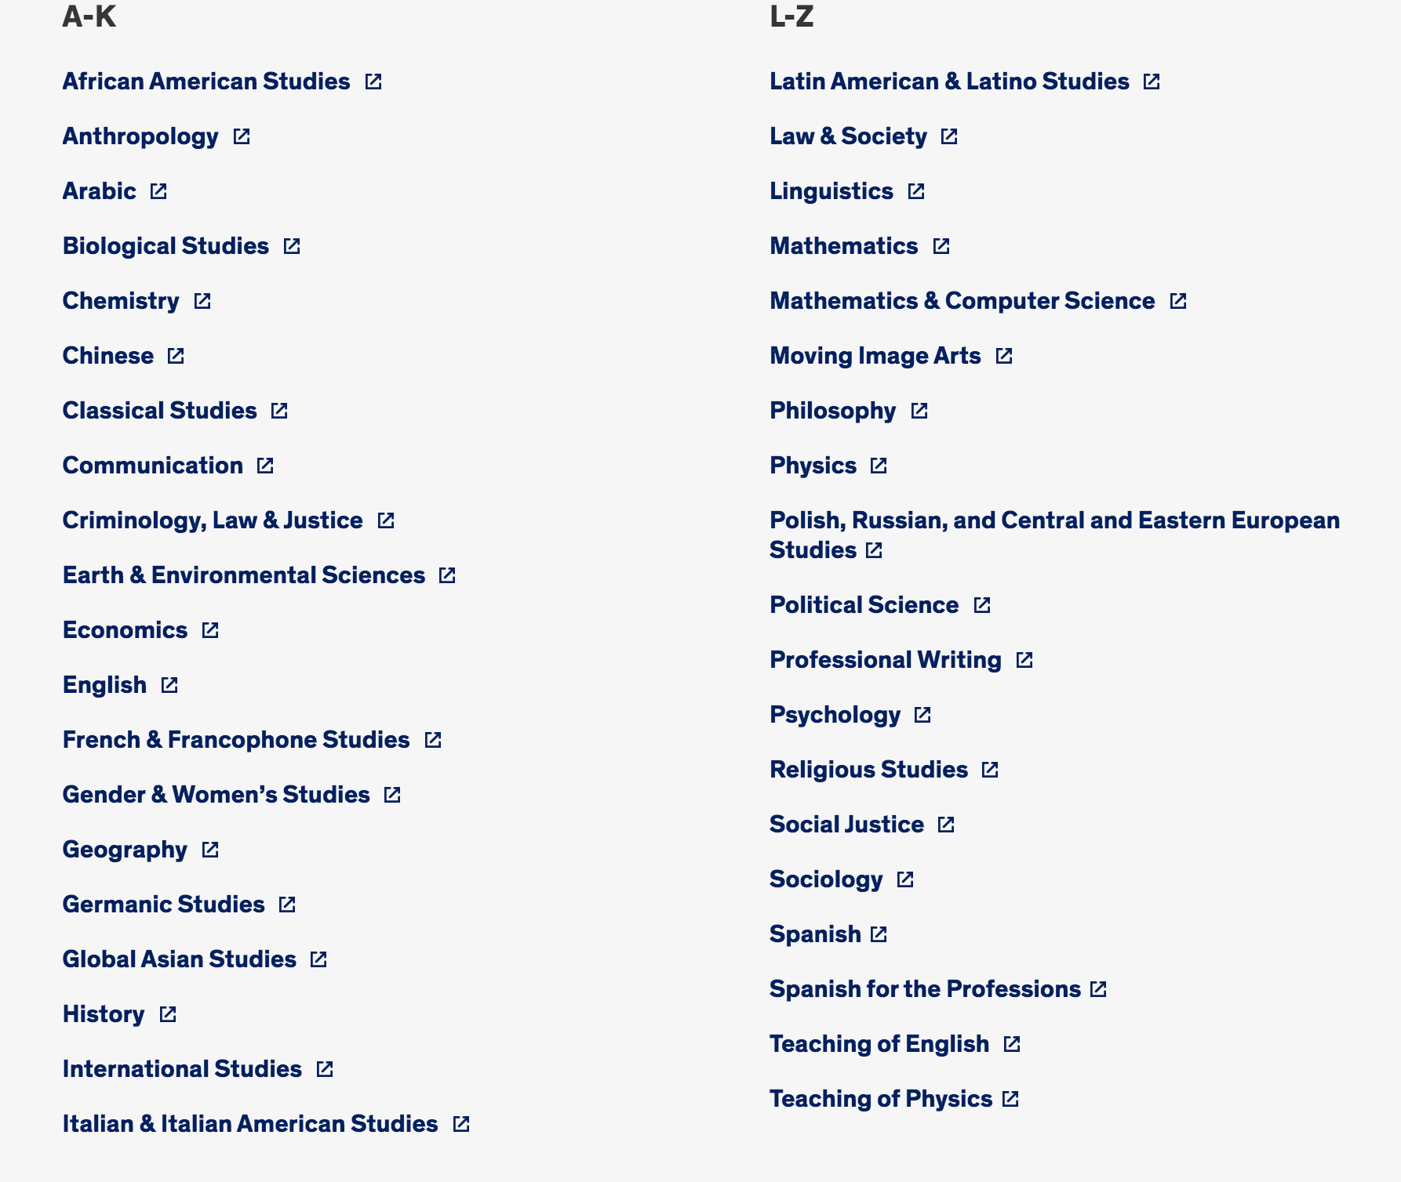
Consider Declaring a MINOR
Ma
Minor in something you are interested in
It can be Music, Public Policy, History, Art
There is a lot of options!

Slide 8
Do you need Orgo 2 and Anatomy?
A
For the DAT
For Dental School
Yes & No
Both can be incredibly useful, however they can be self studied if unable to take the class before DAT
Both classes are more in depth than the DAT
Anatomy: Varies from school to school, many highly recommended anatomy whilst some require it (i.e. Midwestern)
Orgo 2: Varies from school to school

Slide 9
Meeting with Your Advisor
A
Utilize UIC Pre-Health advisors to receive feedback and check in regarding academic standing and planning
Dr. Cohen is also a wonderful resource as she can provide great insight for any questions in which you may have
rcohen@uic.edu

Slide 10
Resources
Mo
These resources are here for YOU! Utilize them!
Tutoring Centers
MSLC
Writing Center
Burnham Hall Tutoring (HC students)
Major-Specific Advisors
Pre-Health Advisors
General LAS Advisors

Slide 11
Planning Classes Alongside DAT
Mo
Create a schedule which allows for a light load
Try your best to allow for “free days”
Save tougher classes till after (Genetics, Physics, Orgo 2)
Try to wake up earlier and utilize mornings

Slide 12
Planning Ahead
Ma
Really plan what you want to do
See when you want to take DAT
What classes you want to take with DAT
When declare major ?
What to declare major?

Slide 13
Academic Confidence
Ma
To succeed, you genuinely have to believe in yourself.
Success is a balance between being tough on yourself and having grace with yourself.

Slide 14
Any Questions?

Slide 15
“Are doing the pre-requisites to dental school enough?”
Ma

Slide 16
Breakout Groups
Group 1 - Maryam
Beyond Pre-Requisites
Group 3 - Cammy
Course Advice
Group 2 - Mohammad
DAT Advice
Group 4 - Aya
Study Tips /Time Management /Success Mentality
We will rotate after a few minutes!

