Slide 1
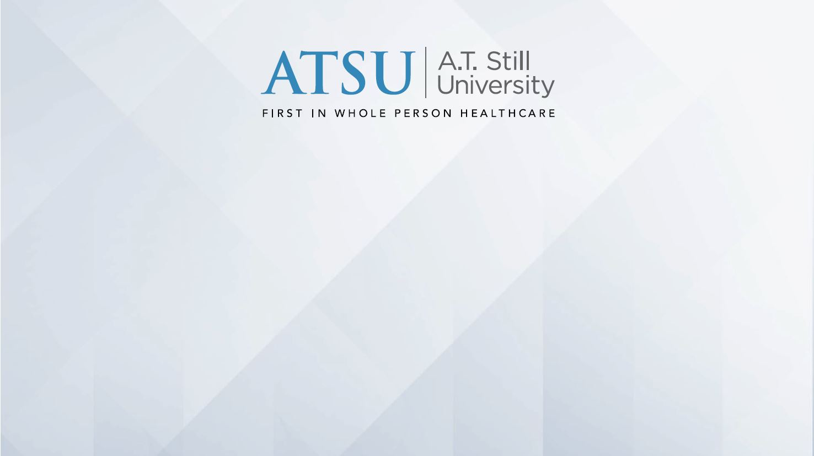
Doctor of Dental Medicine

Slide 2
A.T. Still University
Arizona School of Dentistry & Oral Health
Missouri School of Dentistry & Oral Health
Kirksville College of Osteopathic Medicine
School of Osteopathic Medicine in Arizona
Arizona School of Health Sciences
College of Graduate Health Studies
College for Healthy Communities
Notes:
Showing that ATSU is a nationwide school with campuses in AZ, MO, and CA. with distance sites on over <100> different locations around the country.

Slide 3
A.T. Still University
Arizona School of Dentistry & Oral Health
Missouri School of Dentistry & Oral Health
Kirksville College of Osteopathic Medicine
School of Osteopathic Medicine in Arizona
Arizona School of Health Sciences
College of Graduate Health Studies
College for Healthy Communities
Notes:
Showing that ATSU is a nationwide school with campuses in AZ, MO, and CA. with distance sites on over <100> different locations around the country.

Slide 4
Mission Statement
A.T. Still University of Health Sciences serves as a learning-centered university dedicated to preparing highly competent professionals through innovative academic programs with a commitment to continue its osteopathic heritage and focus on whole-person healthcare, scholarship, community health, interprofessional education, diversity, and underserved populations.
Notes:
Emphasis on “Whole Person Healthcare”, Osteopathic Heritage and service to the underserved

Slide 5
Mission Statement
A.T. Still University of Health Sciences serves as a learning-centered university dedicated to preparing highly competent professionals through innovative academic programs with a commitment to continue its osteopathic heritage and focus on whole-person healthcare, scholarship, community health, interprofessional education, diversity, and underserved populations.
Notes:
Emphasis on “Whole Person Healthcare”, Osteopathic Heritage and service to the underserved

Slide 6
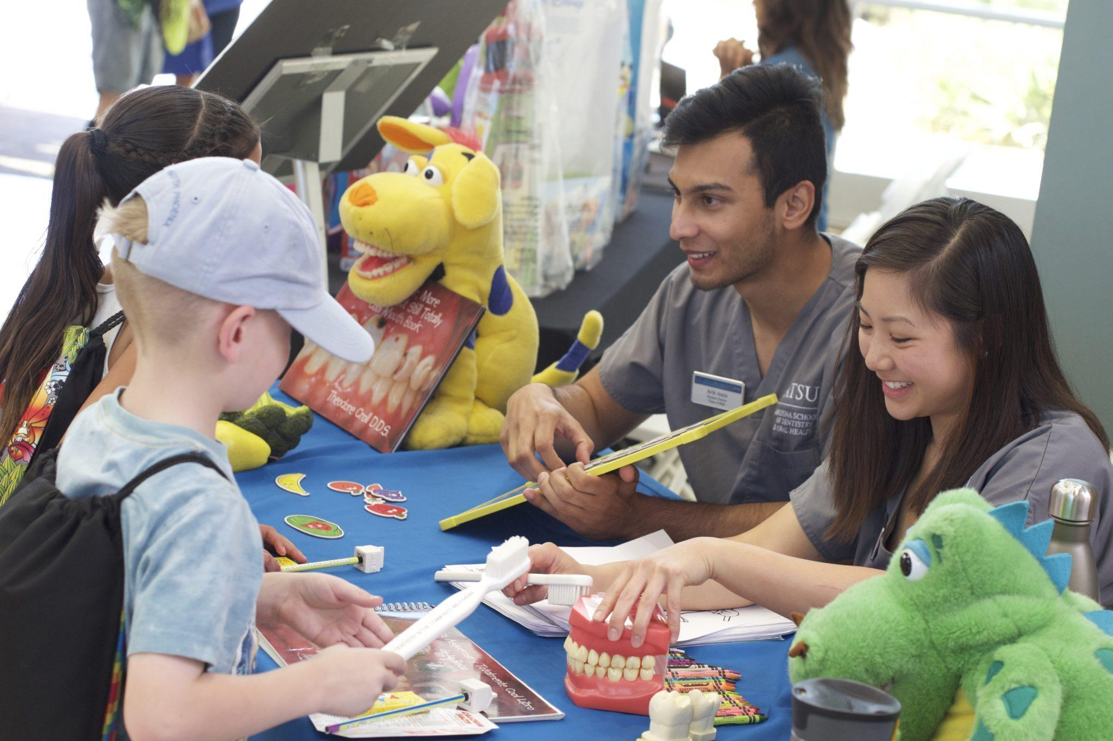
ASDOH Mission
Educate compassionate community-minded oral health providers to lead the profession.
Notes:
Service to the community and public health awareness

Slide 7
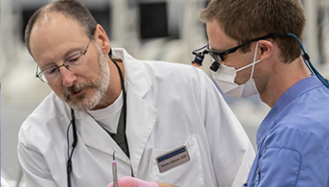
MOSDOH Mission
Committed to the advancement of educational excellence, scholarship, community service, diversity, inclusion, leadership, and technology.
Notes:
Service to the community and public health awareness

Slide 8
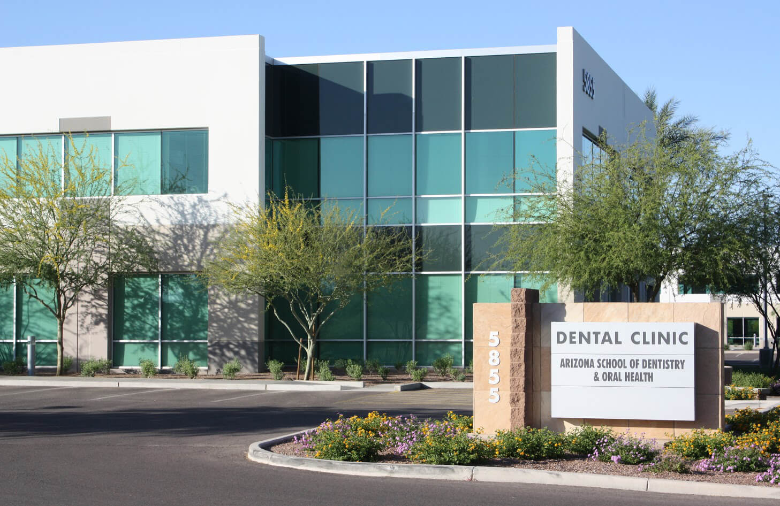
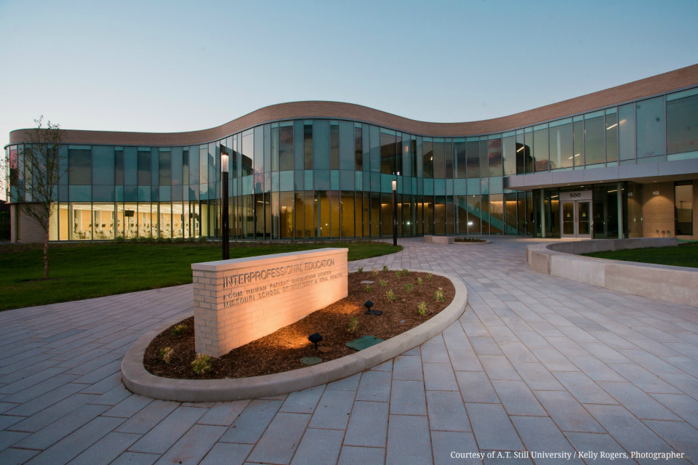
Arizona School of Dentistry & Oral Health
(ASDOH)
Missouri School of Dentistry & Oral Health
(MOSDOH)

Slide 9
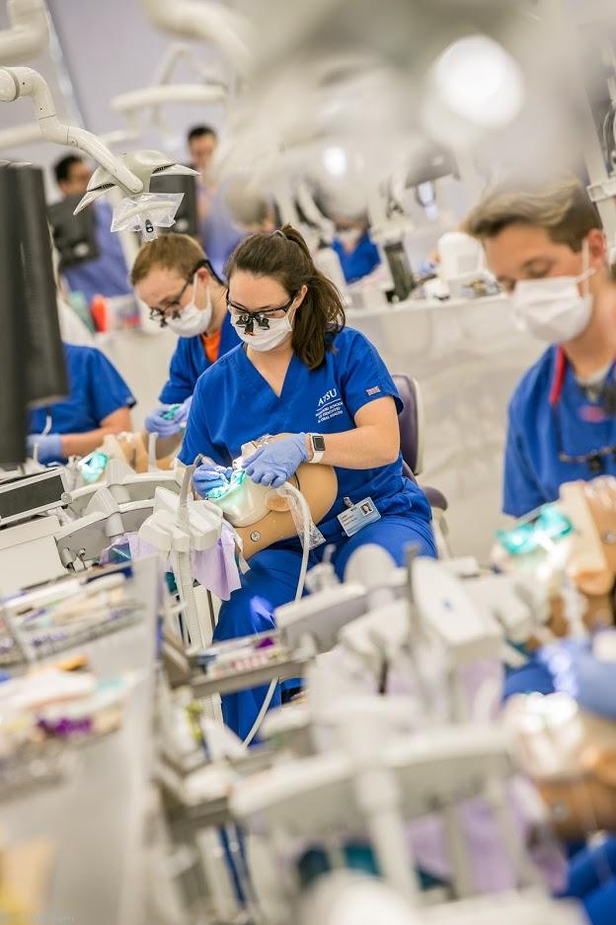
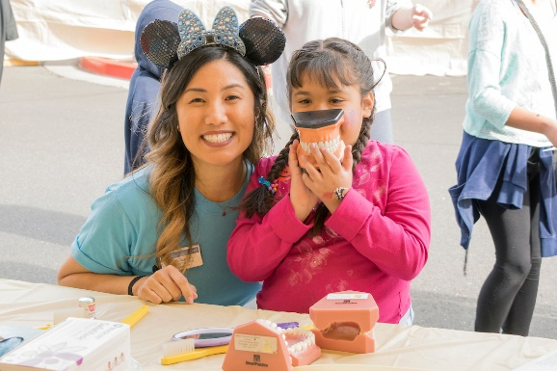
MOSDOH Advantages
Early clinical exposure
Integrated curriculum
Public Health Certificate
Community service
Special needs experience
Cutting edge technology
Interprofessional Education (IPE)
Notes:
Early Clinical Exposure:
Students gain clinical experience before D3 & D4 years.
MOSDOH students get experience starting D1 year through shadowing & assisting experience.
Clinical experience and patient interaction through community service activities starting D1 year.
SIM lab experience starting D1 year.
Integrated Curriculum:
Basic science and clinical courses are integrated throughout the curriculum.
Both programs have a unique curriculum structure, but follow a systems-based model.
National Rotation Sites in Underserved Areas:
Both schools partner with Community Health Centers and Indian Health Services locations to offer external rotations D4 year.
Public Health Certificate:
An online public health certificate program is integrated into both programs’ curriculum.
Students have the option of completing more coursework to earn their MPH after graduation.
Community Service:
ASDOH and MOSDOH have a very strong focus on community service and serving underserved populations.
Community Dentistry is incorporated into the curriculum for both programs.
Students participated in community service activities D1 through D4 years.
Some activities include: GKAS, Lessons in a Lunchbox, Dentures for Veterans, A Day for Special Smiles (for kids with special needs).
Special Needs Experiences:
Students get exposure to special needs care.
Each of our clinics have wheelchair dental chairs, bariatric chairs and stations to care for special needs patients.
Cutting Edge Technology:
Students start their clinical experience in our innovative SIM labs. – One student per station – All equipment is provided so none needs to be purchased by the student.
Students use iPads.
In clinic students get to work with technology including 3D x-ray, Panoramic X-ray, Special needs equipment, and CAD-CAM technology.

Slide 10
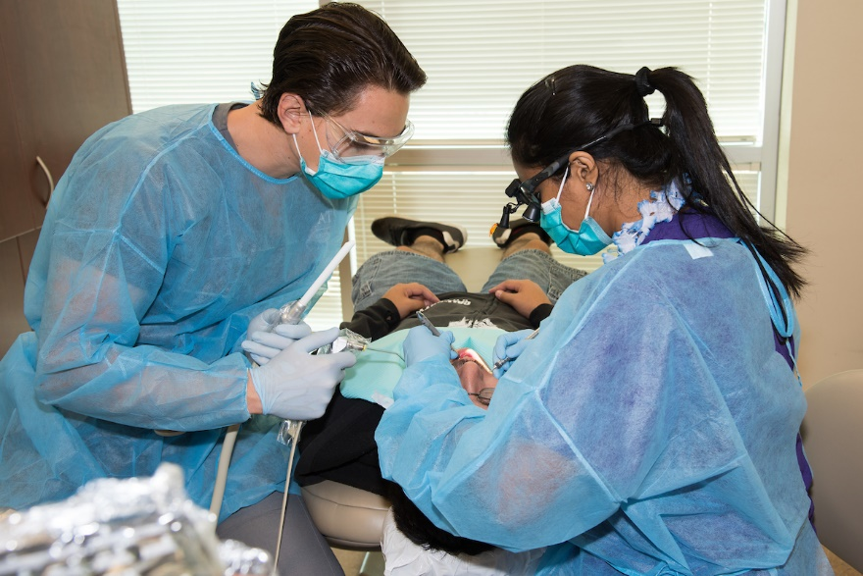
Unique to ASDOH
Immersion Style Modular/Spiral Curriculum – case based format
Onsite patient centered comprehensive clinics
Extensive clinical exposure
External rotations
70 locations
nationwide
4 to 5 rotations
Duration 4-5 weeks each
Notes:
Curriculum based on a modular approach ( modules within each didactic course )
The curriculum has been newly redesigned to help students more quickly integrate singular concepts into patient cases or scenarios, so they can more readily understand how to apply what they are learning as well as retain that information. Actively expanding our use of asynchronous, case-based and spiraled curriculum .
Didactic courses and simulation clinic is staggered throughout the D1/ D2 to allow students to participate in ASDOH comprehensive care clinics
Students have hands on clinical experiences in the D1 year.
8-10 patients per day in 4th year
Onsite Clinic
D3 and D4 years students are doing internal rotations in various specialty disciplines at our clinics on site.( Endo , Ortho OS, Special Needs, etc.)
The clinic spans over two buildings and has robust special needs area
Students with interact with AEGD and Ortho residents on patient cases.
You will go through core rotations and practice general dentistry in one of our 4 CCU’s
External Rotations
70 Community Health Centers across the country for 4 to 5 nationwide fourth-year away rotation sites.

Slide 11
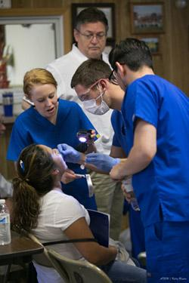
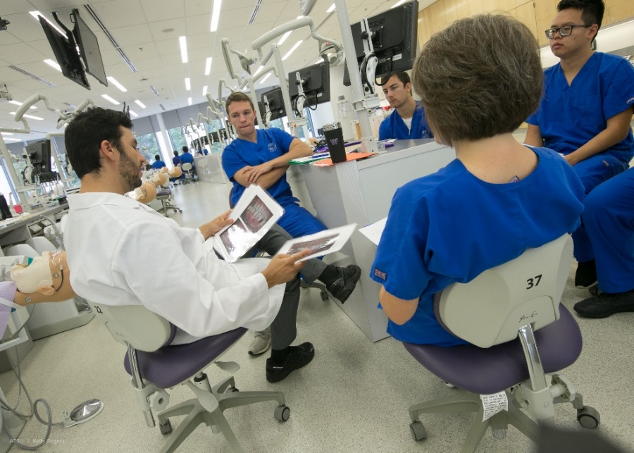
MOSDOH Advantages
Integrated, hybrid case-based curriculum
Two locations (Kirksville & St. Louis, MO)
Interprofessional education
Clinical experiences starting first year
Partnership with Affinia Healthcare – a Federally Qualified Health Center
Advanced Standing International Dentist Program (ASID)
Notes:
Systems based curriculum
Courses are taught according to systems.
Students will be enrolled in the following seven courses throughout all four years of the program: Biomedical Sciences & Dental Sciences; Scientific Practice; Oral Healthcare Delivery; Interprofessional Education & Interprofessional Collaborative Practice; Professionalism, Ethical Practice, and Behavioral Sciences; Skills Acquisition; Person-Centered Care
Basic science courses are integrated with clinical experiences throughout the program – Basic science courses will be fully integrated through D4 year for the class of 2024.
Includes Case-based and Problem-based learning
Integrated block exams. – 3-6 exams per semester that will cover multiple topics for the seven courses. – Midterm integrated block exam & final block exam.
Two Locations
MOSDOH students will attend classes D1 & D2 year in Kirskville, MO,
They will then spend D3 and most of D4 year at our clinic in St. Louis, MO.
Interprofessional Education
We are the only dental school that currently has a course called IPE.
Online course with opportunities to work with KCOM students 1st year.
Elective courses through AHEC.
During D3 & D4 years students work with Pharmacy students in Intake clinic.
We have partnerships with SLU so that students can do grand rounds.
Clinical Experiences Starting 1st Year
Students start gaining clinical experiences during rotations D1 and D2 years (shadowing, light assisting and non-complex procedures).
First clinical experiences are peer on peer.
Students will have rotations in the SIM lab, at NEMO Health Council, and at our clinic in St. Louis.

Slide 12
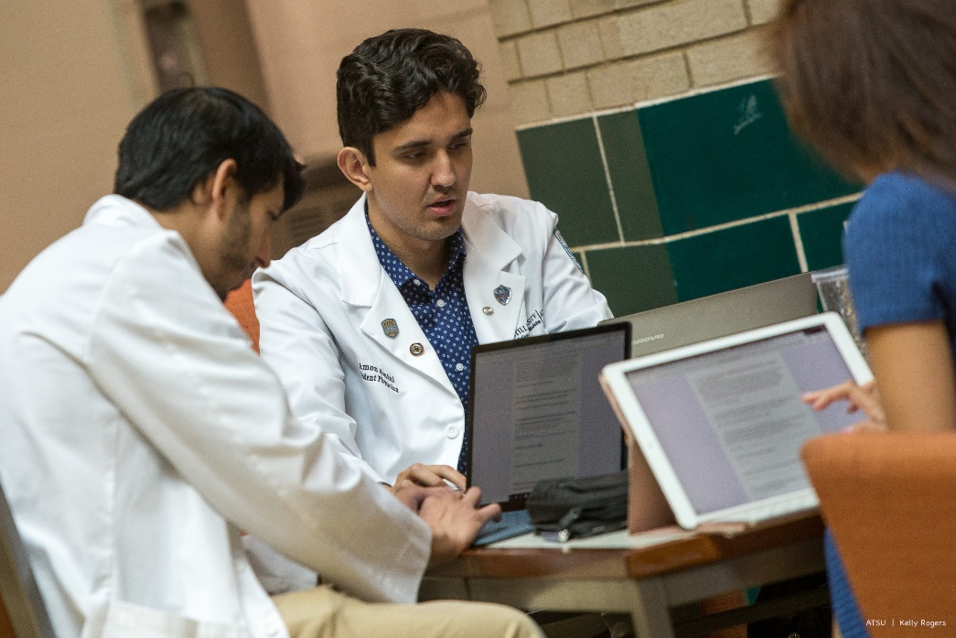
MOSDOH Still Scholars Program
Professional development topics
Guided mentorship
Community research project
Competitive admissions requirements
Exclusivity agreement
No DAT
Notes:
Professional Development
Applicants accepted into the program are mentored by admissions staff and student ambassadors
Complete online professional development courses
The last year of the program students will submit an application and complete a final interview before being accepted into KCOM.
Competitive Admissions Requirements
Application is due by August 1 following sophomore year – unless two years of undergrad coursework are still planned after the junior year.
Applicants should have about 50 hours of shadowing, community service, and leadership completed at time of application.
Exclusivity Agreement
When accepted into the program, students must sign an agreement stating that they will not apply to other medical schools until they receive a decision from KCOM.
No DAT
A perk to the program is that students do not have to take the DAT.
The DAT should NOT be taken at all, and DAT scores should not be released to AADSAS.

Slide 13
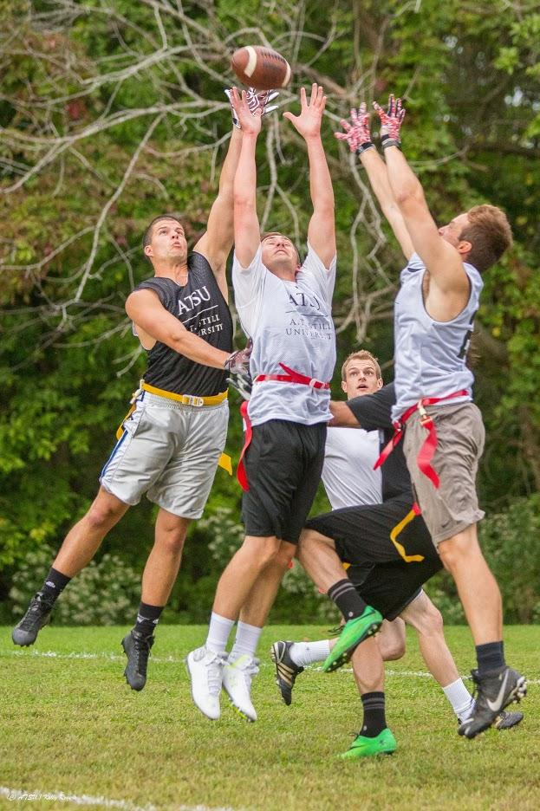
Campus & Community
Student-centered support
Clubs and organizations
Stillwell healthy lifestyle
Kirksville and St. Louis communities
Notes:
Student-Centered Support
Low Faculty: Student Ratio
Learning & Disability Resources
Tutoring
Counseling Services
Clubs & Organizations:
Still Support Organization
Intramurals
Student Organizations
Still Well Healthy Lifestyle
Free access to fitness facilities (Kirksville – TCC & Aquatic Center; Mesa – YMCA)
Still-Well program
Meditation room
Mesa and Kirksville Communities
Kirksville: Rural town with population of about 18,000. Regional Fairs, Performers, Farmer’s Market, Local Arts Fairs, Thousand Hills State Park.
Mesa: Phoenix is the 5th largest city w/ sports, entertainment, culture, etc.; Close to nature: Sedona, Flagstaff, Grand Canyon, etc.; Launching pad to LA, San Diego, Las Vegas, Utah, Colorado, and Mexico.

Slide 14
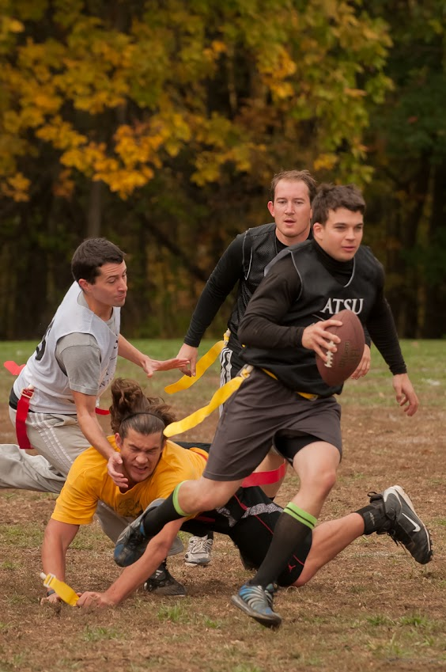
Competitive Application
Bachelor’s Degree
Average GPA: 3.4-3.6
DAT: 19-20
Prerequisites within 5 years
Strong letters of recommendation
Clinical exposure
paid and non-paid
Community service
clinical & non-clinical
Leadership
Notes:
Bachelor’s Degree
A Bachelor’s Degree of at least 90 credit hours are required (Bachelor’s Degree strongly recommended).
Required coursework must be taken at a regionally accredited institution in the United States.
Average GPA
Cumulative and Science GPA that’s at or above our averages.
We like to see an upward trend.
DAT
We don’t want to see more than one section below a 17.
Prerequisites
Biology w/lab
General Chemistry w/lab
Organic Chemistry w/lab
Physics w/lab
Biochemistry
Human Physiology
Human Anatomy
English
Letters of Recommendation
Pre-Health Advisor or Science Faculty member
Dentist
Community Service Supervisor (not required, but recommended)
Clinical exposure
Shadowing experiences or dental experience.
We would like to see variety of specialties.
Baseline of at least 100hrs.
Community Service
Our dental programs have a VERY strong emphasis on community service and public health.
We like to see consistency and dedication to orgs and community service.
Exposure to underserved populations preferred.
Leadership
Leadership experiences and commitment to orgs is preferred.

Slide 15
Application Tips
Research schools before applying
Fit to mission?
Academic averages similar to yours?
Build a competitive application
Address red flags
Personalize essays - Use examples
Have strong letters of recommendation
Prepare for the DAT
Notes:
Do your research
Mission/Fit
Is the mission a match for your goals?
Visit campus or find out what the environment is like.
Class Averages
Find out class average stats (i.e. GPA, MCAT scores, average hours of experience)
Don’t just ask about minimums.
Timeline
Research deadlines for each school.
Find out if the school is on rolling admissions, and when the best time to apply would be.
Build your application
Show Humility and Motivation
Be Detailed and Thorough
Proofread
Build Relationships
Avoid red flags
Irresponsibility
Blames others for mistakes.
Makes excuses for poor performance or discipline.
Lacks professionalism.
Inexperience
Lack of clinical and community service.
Lack of variety in clinical experiences.
No leadership/experiences can demonstrate a lack of commitment.
No Passion/Conviction
Make sure that personal statement and secondary essay answers show a passion for medicine.
Omitting Discipline
Make sure that all discipline issues are addressed, even if they are expunged.
Lacks People Skills
No patient interaction can hurt your competitiveness.
Show strong communication skills and people orientation in your application.
Personalize essays

Slide 16
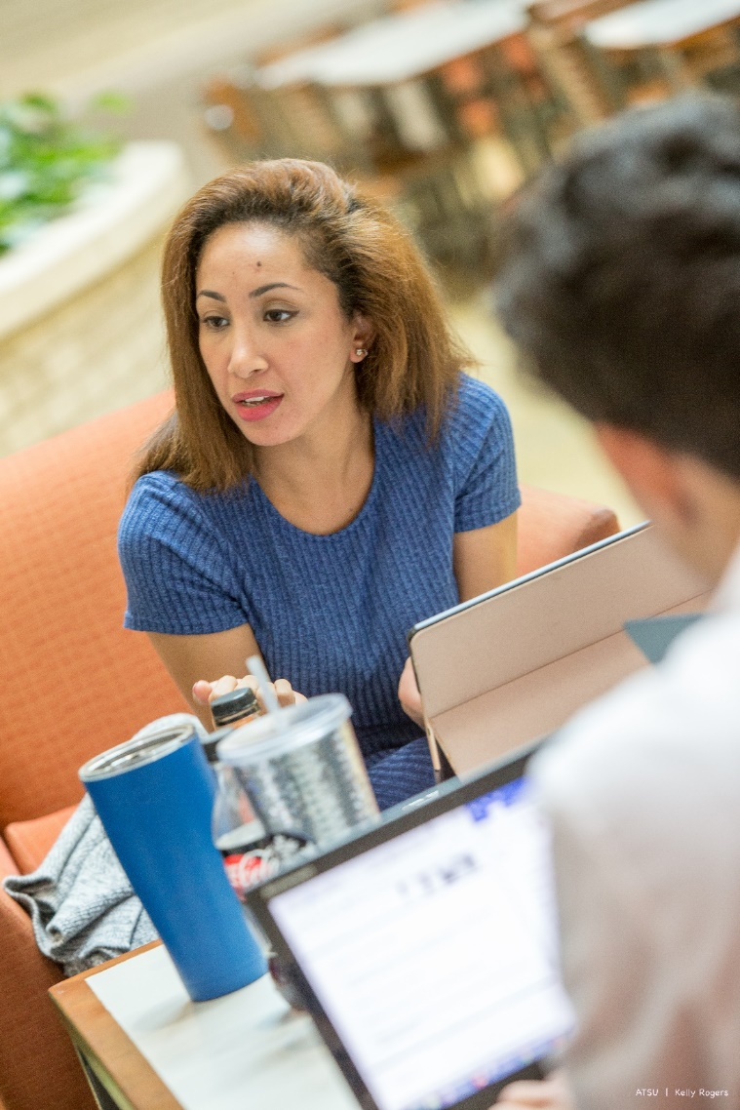
Services We Offer
Application advisement
Transcript review
Interview tips
Campus Tours
Connect with a Current Student
Notes:
Application Advisement
Individual in person, phone or email advisement.
Transcript Review
We can review transcripts and offer guidance on how competitive academics are.
Personal Statement Feedback
We can give advice about effective ways to write a personal statement. We cannot review or critique personal statements, though.
Interview Tips
We can offer interview tips or mock interviews in person or via Zoom.

Slide 17
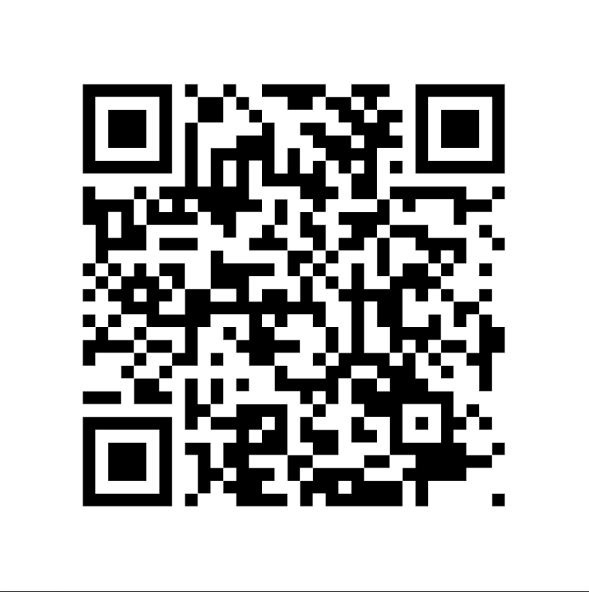
ATSU Admissions Office
Professional Development Services
Virtual Workshops
Interview etiquette
Mock interviews
MCAT/DAT prep
History of Osteopathy
Follow us for our events!
Use of services or attendance to programs does not impact your chances for an interview or acceptance at ATSU.

Slide 18
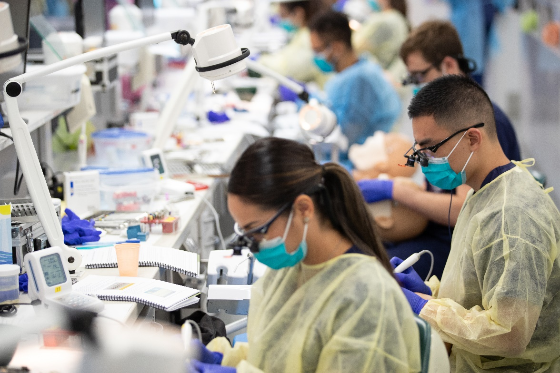
Contact Us
www.atsu.edu/admissions
866.626.2878 x 2237
Admissions@atsu.edu

