Slide 1
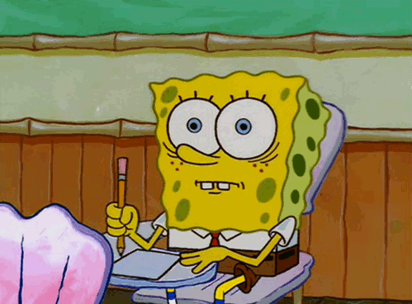
How to Student
PRESENTED BY PDC

Slide 2
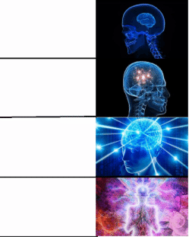
Mission 1: Mentality and Confidence
Reaching the mentality that “yes I am 100 % capable”
Not comparing yourself
You are your own competition
Surrounding yourself with people that lift you up
Attaining the skill of self reflection and not self hating
encouraging
others
surrounding myself with good people
not comparing myself
believing in myself

Slide 3
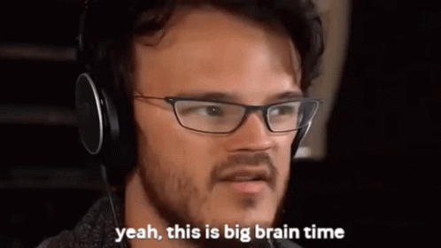
Mission 2: Strategy/Skills
Figuring out what type of learner you are
Learning from your peers
Time management
Setting goals continuously
Set short/long term goals

Slide 4
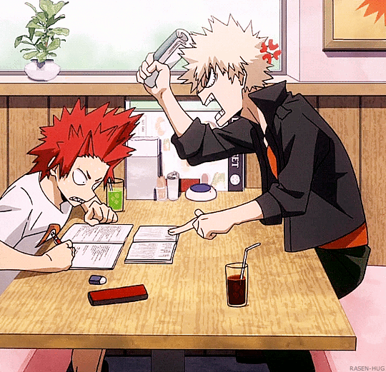
Mission 3: Resources at UIC
MSLC
Tutoring
LARES @ SSB
Tutoring
Pre-dental club :)
Mentor program :)
DAT study Groups :)
AAAN Tutoring
Tutoring
Therapy
https://counseling.uic.edu/services/individual-therapy/

Slide 5
Mission 4: Connect to Professors and TAs
Ask about coursework, research, or random questions!
Improves networking skills
Make meaningful connections with faculty!
Leads to opportunities and/or resources
Strengthens strong relationship which builds trust
You never know what you might learn!
You never know where it’ll take you in the future!
It’s all about the friends we make along the way

Slide 6
Mission 5: Physical Health is as Important as Mental Health
Be sure to stay active and eat a healthy and well balanced diet!
Working out releases endorphins, which help your brain with stress :)
Eating healthy helps your body + teeth (vitamins, immune support etc.)
Take breaks and do things that help relax your body
Exercise (going for a walk, run, lifting weights)
Self-care (face mask, bubble bath, etc.)
SLEEP (7-8 hours is best!)
Remember, Health is Wealth

