Slide 1
WELCOME TO THE PRE-DENTAL CLUB
at the University of Illinois at Chicago

Slide 2
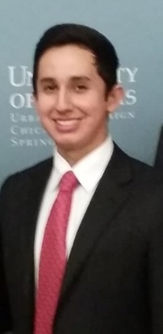
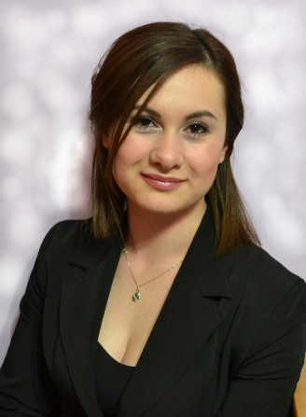
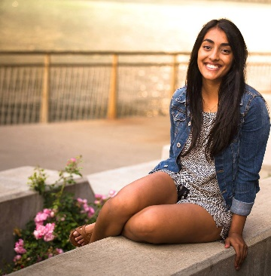
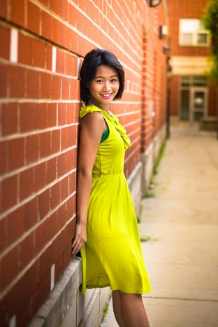
Meet Your 2015-2016 Executive Board
President-Michael Carrera
Treasurer-Sotiria Tzavara
Vice President-Vanesha Mistry
Secretary-Ira De Los Reyes

Slide 3
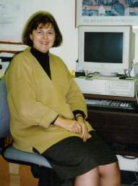
Pre-Dental Club Advisor
Dr. Rhonna Cohen
Email: Rcohen@uic.edu

Slide 4
Who We Are/What We Are About/What You Can Expect
The Pre-Dental Club of the University of Illinois at Chicago is a student-run campus organization that is dedicated to helping students on their way to pursuing a career in dentistry. Through guest speakers, workshops, field trips, community service, social events and much more, the UIC PDC provides opportunities for pre-dental students to gain valuable knowledge and insight into dentistry and creates a place for pre-dental students to form friendships and network with one another.
Our Purpose:
To supply our members with current information about health sciences.
To provide a medium for guest speakers to come and speak to those interested in the oral health care.
To give back to the community by providing service oriented volunteer work to local health care institutions.
To provide academic support for our members in regards to the dental school application process.

Slide 5
Overview of the Fall 2015 Semester
8 Meetings (definitely more TBA) What do we want to focus on?
Volunteering, Special Events, Tours, Social Gatherings
Various Workshops
Meeting Minutes/Post-Meeting Surveys
Becoming an Active Member
Points System
Dues/T-Shirt/Membership Fee
Website Pictures/Social Media
OPDM- “Outstanding Pre-Dent of the Month”
Office Hours
E-Board 2016-2017
Next Meeting 9/24/15 UIC Admissions Counselors

Slide 6
8 CONFIRMED Meetings
Focus of this Academic Year?
Dental School Visits, Tours, Inviting Admissions Counselors. (Midwestern, SIUE, UIC, Marquette, Case Western)
UIC College of Dentistry: Specializations Offered/Residency Programs
Prosthodontics, Endodontics, Periodontics, Pediatric Dentistry, Orthodontics, Oral/Maxillofacial Surgery

Slide 7
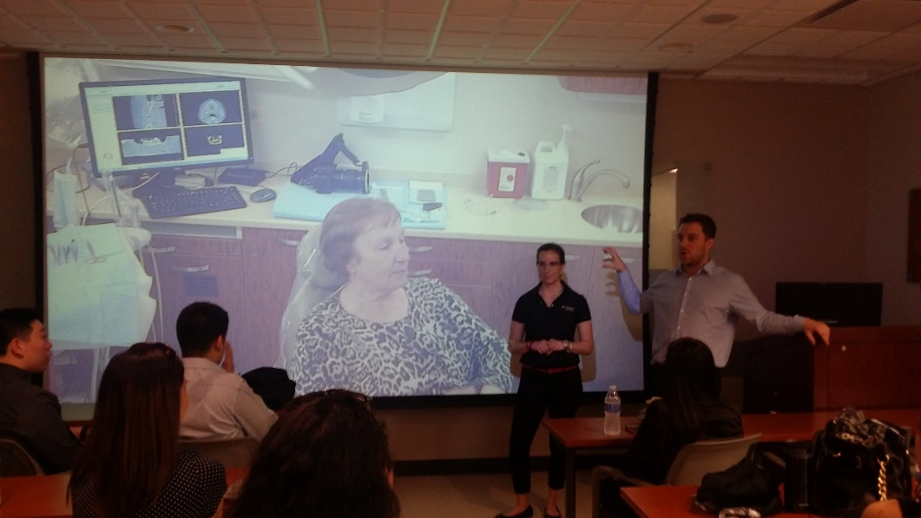
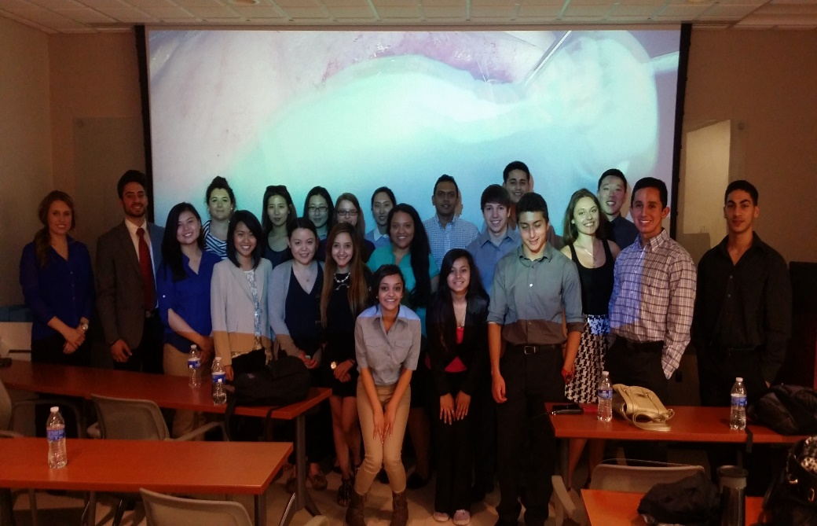

Slide 8
Volunteering, Special Events, Tours, Social Gatherings
VP-Vanesha Mistry on Volunteering
Dental School Visits, Stays
Fundraisers (Ria), 5K Runs, Chicago Marathon, Bake Sales, Toothbrush drive, Teach Oral Health Education, Big Sib/Lil Sib
ADA Building Tour in Chicago

Slide 10
Workshops
We want to know what YOU need help with!
Freshman-Senior Status (Very different stages in the game)
DAT Studying Tips, Interview workshops, personal statement help, course studying tips, major studying tips, reaching out to dentists for shadowing, undergraduate research experience, volunteering experience, job experience, leadership workshops, obtaining letters of recommendation
According to the ADA, as of 2013 there are 195,202 licensed dentists in the USA. Of those 195K, roughly 9,000 of them practice in Illinois.
Roughly 240 newly licensed dentists come from IL alone, every year.

Slide 11
Meeting Minutes/Post-Meeting Surveys
Busy Schedule? WE UNDERSTAND. JUST TELL US.
Utilize our website: uicpdc.weebly.com
We want your FEEDBACK, we want your IDEAS, we want to answer any QUESTIONS you have.
Minutes will be posted the night of the meeting or latest morning after meeting.
Post-meeting survey link will be sent via email

Slide 12
Becoming an Active Member
15x PTS required to remain on the MASTER LIST and to be considered ACTIVE for the 2015-2016 UIC Academic Year.
What are PTS for? ☺
Active Member Roster will remain listed on our club website for every academic year .UIC College of Dentistry Admissions will use this as a means of confirming WHO is/has been active. (at the end of each year)

Slide 13
Points System
Ways to Earn Points
2x PTS earned per meeting attended
1x PTS earned per 10x toothbrush, toothpaste, floss, mouthwash, etc. donated. (MAX 6x PTS per semester)
2x PTS earned per outside event/volunteer event attended (e.g. COD Open House, COD Pre-Dental Night, Midwinter Meeting, etc.) (NO LIMIT)
2x PTS earned per 10hrs Shadowing. (Signature of DR required for verification) (MAX 4x PTS per semester)
5x PTS earned for registering to be ASDA pre-dental member.
Penalties
4x PTS deducted for last minute cancellations of ANY committed event unless provided with *valid excuse through email by no later than 10pm day of the event. (if member cancels anytime from the moment you committed to the start of the event)
1x PTS deducted for failure to follow instructions for event. (e.g. improper dress attire, late arrival, etc.)
WHY DO WE DO THIS?

Slide 14
Dues/T-Shirt/Membership Fee
DUES-(Ria)
1 Semester Payment Option
Cost: $15
T-Shirt cost is separate for Fall 2015.
T-Shirt will be provided only if there are any remaining leftover for Spring 2015.
Inactive Member Status. (unless member fulfills 15x PT requirement)
2 Semester Payment Option
Cost: $25
T-Shirt included in price.
Active Member Status. (unless member doesn’t fulfill 15x PT requirement)
What do DUES go towards?
Food that is provided for members at every meeting.
Annual PDC T-Shirt order.
Dental School Visits, Social Events, other events

Slide 15
Website/Pictures/Social Media
UICPDC.weebly.com
www.facebook.com/uic.pdc
www.Instagram.com/uicpdc
PICTURES
CONSISTENT UPDATES
Great way to communicate with other Pre-Dents and to contact us!
Group Photo with FLAG

Slide 16
OPDM
“Outstanding Pre-Dent of the Month!”
Outstanding Pre-Dent of the month will be provided with a certificate and will have picture taken and posted onto the club website. Nominations for OPDM must be emailed no later than 7 days before the end of the month. New OPDM’s will be voted on by e-board and announced at the beginning of each month. OPDM’s will be voted on based on:
Meeting Attendance
Active Participation
Attitude/Smiling
Going Above and Beyond

Slide 17
Office Hours
Office Location: 380H Campus Programs SCE (above Subway/Sbarro, Wendy’s restaurants)
Office Hours: Thursdays 3:30pm-5:00pm
Vanesha Availability: 11am-2pm, 3:30pm-5pm
Ria Availability: 12:30pm-2pm, 3:30pm-5pm
Michael Availability: 3:30pm-5pm
Ira Availability: 3:30pm-5pm
Additional Hours/Meeting times can be scheduled by any member through email for an appointment with an e-board member.

Slide 18
E-Board 2016-2017
30x PTS REQUIRED to apply to run for a position on executive board for 2016-2017. Application deadline date TBD.
5-Min Speech required for all 4 positions.
Getting to know the CURRENT e-board (especially position you want to run for) also required.
2nd Semester date/time for elections TBD

Slide 19
UIC Community
DIVERSITY
UNIQUENESS
What inspires you? What motivates you?
One Mutual Goal: to become dentists
Big sib/lil sib

Slide 20
Wrapping Things Up
Next meeting, Thursday, 9/24/15, 5pm-6pm, Rm 613
UIC Admissions Braulia Espinosa and Carolyn Feller
UIC COD- 801 S. Paulina Street
INTRODUCE YOURSELF! Make the best out of your college undergrad experience!

